Slide 1
INTERNSHIP • 8 WEEKS
EDUVISION_DV
LIVE ANALYTICS
Higher Education
Performance Dashboard
Global Score
Universities
72.6
1,503
Intl. Students
Publications
28.7%
2.45M
Transforming university data into interactive,
data-driven insights with Tableau.
UNIVERSITY PERFORMANCE
PRESENTED BY
ORGANIZATION
Mahesh Deshmukh
Springboard InfoSys
PYTHON • PANDAS • TABLEAU
Internship Presentation
01

Slide 2
Internship Overview
01
A focused 8-week journey from data preparation to interactive analytics.
HOME
Overview
Tech
Project
KPIs
Architecture
Modules
Contribution
Results
HOME
OVERVIEW
TECH
PROJECT
KPI
ARCH
MODULES
WORK
RESULTS
Organization
Duration
Project
Role Focus
Springboard InfoSys
8 Weeks
EduVision_DV
Data + Visualization
INTERNSHIP FLOW
01
02
03
04
05
Collect
Clean
Engineer
Build
Test
Data
Transform
KPIs
Dashboards
Deliver
02
EDUVISION_DV • SPRINGBOARD INFOSYS
02
EDUVISION_DV • INTERNSHIP PROJECT

Slide 3
Technologies & Tools
02
The stack used for collection, processing, visualization and delivery.
HOME
Overview
Tech
Project
KPIs
Architecture
Modules
Contribution
Results
HOME
OVERVIEW
TECH
PROJECT
KPI
ARCH
MODULES
WORK
RESULTS
Py
PYTHON
Pd
PANDAS
Np
NUMPY
Data collection & cleaning
Data processing
Numerical operations
Tb
TABLEAU
Gh
GITHUB
Kg
KAGGLE
Interactive dashboards
Documentation & delivery
Dataset source
03
EDUVISION_DV • SPRINGBOARD INFOSYS
03
EDUVISION_DV • INTERNSHIP PROJECT

Slide 4
Project Introduction
03
Problem statement and purpose derived from the internship project brief.
HOME
Overview
Tech
Project
KPIs
Architecture
Modules
Contribution
Results
HOME
OVERVIEW
TECH
PROJECT
KPI
ARCH
MODULES
WORK
RESULTS
PROBLEM STATEMENT
EDUVISION SOLUTION
Higher education data contains valuable information
about university rankings, research, students and
academic performance, but analysing it effectively
requires a unified visual approach.
Rankings
Research
Students
The project transforms raw educational data into
interactive insights for university comparison,
performance analysis and global trend exploration.
Countries
4 INTERCONNECTED TABLEAU DASHBOARDS
04
EDUVISION_DV • SPRINGBOARD INFOSYS
04
EDUVISION_DV • INTERNSHIP PROJECT

Slide 5
Objectives
03
What the project was designed to achieve.
HOME
Overview
Tech
Project
KPIs
Architecture
Modules
Contribution
Results
HOME
OVERVIEW
TECH
PROJECT
KPI
ARCH
MODULES
WORK
RESULTS
01
Integrate
02
Clean
03
Engineer
Global university datasets
Prepare consistent analytics-ready data
Develop education-focused KPIs
04
Visualize
Compare
05
Build four interactive Tableau dashboards
Analyse university and country performance
05
EDUVISION_DV • SPRINGBOARD INFOSYS
05
EDUVISION_DV • INTERNSHIP PROJECT

Slide 6
Data Collection & Preparation
03
Kaggle data → cleaning → KPI-ready dataset → Tableau.
HOME
Overview
Tech
Project
KPIs
Architecture
Modules
Contribution
Results
HOME
OVERVIEW
TECH
PROJECT
KPI
ARCH
MODULES
WORK
RESULTS
Kaggle
Python
Cleaning
KPIs
Tableau
Dataset
Source
Collection
& merge
Duplicates • names
• missing values
Six calculated
metrics
Interactive
visualization
DATA PREPARATION FOCUS
Remove duplicates • Standardize university & country names • Normalize ranking metrics • Create Tableau-ready dataset
06
EDUVISION_DV • SPRINGBOARD INFOSYS
06
EDUVISION_DV • INTERNSHIP PROJECT

Slide 7
KPI Engineering
04
Six KPIs calculated from the prepared university dataset.
HOME
Overview
Tech
Project
KPIs
Architecture
Modules
Contribution
Results
HOME
OVERVIEW
TECH
PROJECT
KPI
ARCH
MODULES
WORK
RESULTS
Global Ranking Score
Research Impact Score
Faculty-to-Student Ratio
CALCULATION
CALCULATION
CALCULATION
(Overall Score + Overall SCORE) / 2
(Research Quality + Citations per Faculty SCORE) / 2
(Students to Staff Ratio + Faculty Student Ratio SCORE) / 2
International Student %
Academic Reputation
Research Productivity
CALCULATION
CALCULATION
CALCULATION
(International Students + International Student SCORE) / 2
(Academic Reputation SCORE + Employer Reputation SCORE) / 2
(Research Environment + Industry Impact) / 2
07
EDUVISION_DV • SPRINGBOARD INFOSYS
07
EDUVISION_DV • INTERNSHIP PROJECT

Slide 8
System / Project Architecture
05
End-to-end workflow used to build the dashboard suite.
HOME
Overview
Tech
Project
KPIs
Architecture
Modules
Contribution
Results
HOME
OVERVIEW
TECH
PROJECT
KPI
ARCH
MODULES
WORK
RESULTS
INPUT
01
03
05
07
Collect University
Datasets
Education KPI
Engineering
Dashboard
Integration
Documentation
& Delivery
02
04
06
Data Cleaning &
Transformation
Dashboard
Development
Testing &
Validation
OUTPUT
08
EDUVISION_DV • SPRINGBOARD INFOSYS
08
EDUVISION_DV • INTERNSHIP PROJECT

Slide 9
Modules / Features
06
Four interconnected dashboards built in Tableau.
HOME
Overview
Tech
Project
KPIs
Architecture
Modules
Contribution
Results
HOME
OVERVIEW
TECH
PROJECT
KPI
ARCH
MODULES
WORK
RESULTS
01
University Overview
02
Research Analytics
Rankings • global distribution • reputation • trends
Publications • citations • productivity • impact
INTERACTIVE
INTERACTIVE
03
Student Analytics
04
Country Comparison
International students • ratio • diversity • enrollment
Country ranking • benchmarking • regional trends
INTERACTIVE
INTERACTIVE
09
EDUVISION_DV • SPRINGBOARD INFOSYS
09
EDUVISION_DV • INTERNSHIP PROJECT

Slide 10
My Contribution
07
The work performed across the project lifecycle.
HOME
Overview
Tech
Project
KPIs
Architecture
Modules
Contribution
Results
HOME
OVERVIEW
TECH
PROJECT
KPI
ARCH
MODULES
WORK
RESULTS
DATA
PROCESSING
KPI
Collected & integrated university datasets
Cleaned, standardized and transformed data
Engineered six education performance KPIs
DASHBOARDS
VALIDATION
DELIVERY
Developed and integrated four Tableau dashboards
Tested KPI calculations and dashboard interactions
Prepared documentation and final project structure
10
EDUVISION_DV • SPRINGBOARD INFOSYS
10
EDUVISION_DV • INTERNSHIP PROJECT

Slide 11
Challenges & Solutions
07
Key practical challenges encountered during the workflow.
HOME
Overview
Tech
Project
KPIs
Architecture
Modules
Contribution
Results
HOME
OVERVIEW
TECH
PROJECT
KPI
ARCH
MODULES
WORK
RESULTS
Inconsistent data
Different ranking fields and naming conventions
Standardized fields and prepared a common structure.
→
Data quality
Duplicates / missing values could affect analysis
Applied cleaning and validation before KPI generation.
→
KPI consistency
Multiple source indicators needed a unified metric
Used defined calculation formulas for six KPIs.
→
Dashboard complexity
Multiple analytics views had to work together
Used filters, parameters, actions and dashboard linking.
→
11
EDUVISION_DV • SPRINGBOARD INFOSYS
11
EDUVISION_DV • INTERNSHIP PROJECT

Slide 12
Skills Gained
07
Technical and analytical skills developed during the internship.
HOME
Overview
Tech
Project
KPIs
Architecture
Modules
Contribution
Results
HOME
OVERVIEW
TECH
PROJECT
KPI
ARCH
MODULES
WORK
RESULTS
Python
Pandas / NumPy
Data Cleaning
KPI Engineering
Data handling
Processing
Quality & consistency
Metric design
Tableau
Dashboard Design
Data Analysis
GitHub
Visualization
UX & storytelling
Comparisons & trends
Project delivery
12
EDUVISION_DV • SPRINGBOARD INFOSYS
12
EDUVISION_DV • INTERNSHIP PROJECT

Slide 13
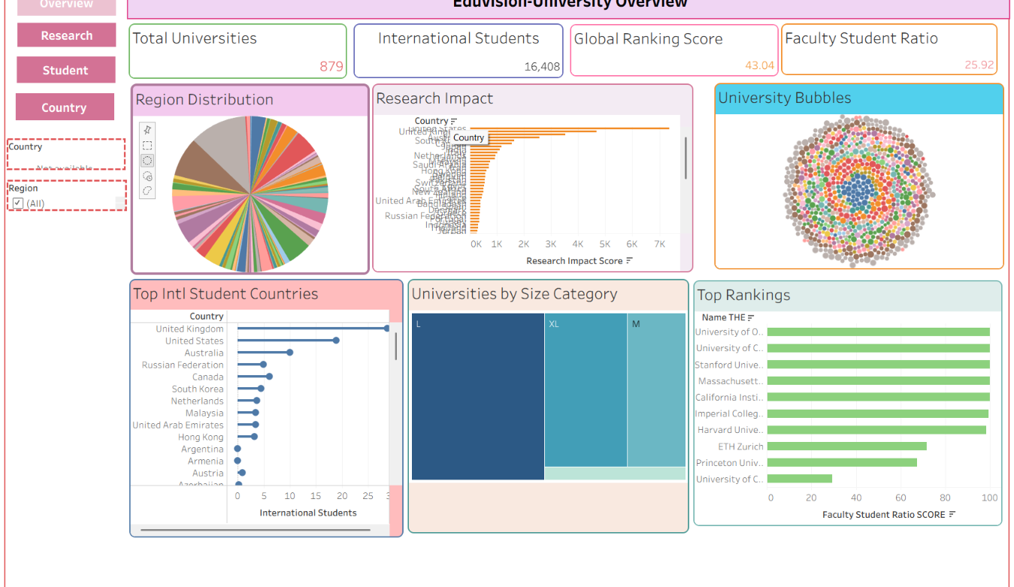
RESULTS / FINAL DASHBOARD
HOME
OVERVIEW
TECH
PROJECT
KPI
ARCH
MODULES
WORK
RESULTS
D1
D2
D3
D4
Ranking, reputation, distribution and university performance at a glance.
01 • UNIVERSITY OVERVIEW
TABLEAU OUTPUT
D1–D4 • click to navigate
PURPOSE
A consolidated view of university performance, rankings, regional distribution and key institutional indicators.
KEY INSIGHTS
879 total universities
16,408 international students
Global ranking score: 43.04
Faculty-to-student ratio: 25.92
UNIVERSITY OVERVIEW • DASHBOARD
NEXT ›
01
EDUVISION_DV • SPRINGBOARD INFOSYS
13

Slide 14
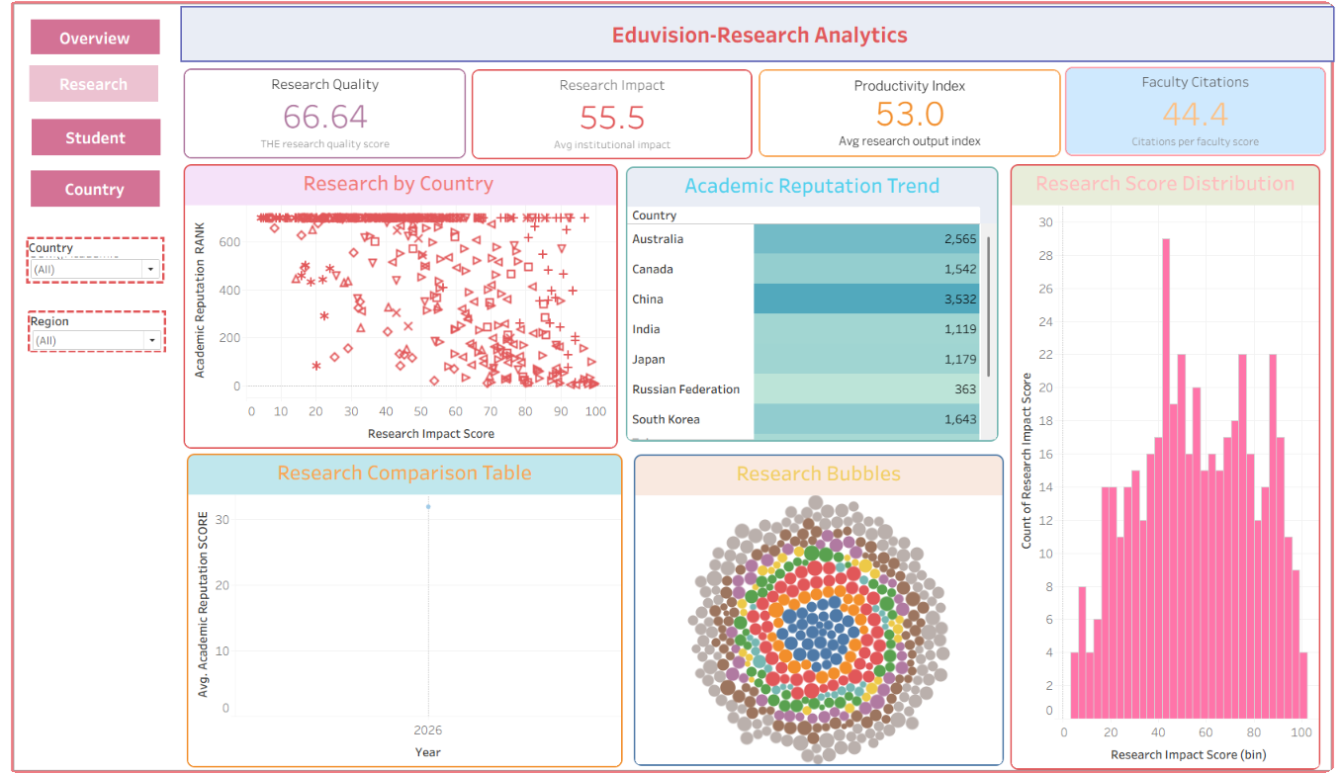
RESULTS / FINAL DASHBOARD
HOME
OVERVIEW
TECH
PROJECT
KPI
ARCH
MODULES
WORK
RESULTS
D1
D2
D3
D4
Research output, citations and institutional research impact.
02 • RESEARCH ANALYTICS
TABLEAU OUTPUT
D1–D4 • click to navigate
PURPOSE
Brings research quality, research impact, productivity and citation performance into one analytical view.
KEY INSIGHTS
Research quality: 66.64
Research impact: 55.5
Productivity index: 53.0
Faculty citations: 44.4
RESEARCH ANALYTICS • DASHBOARD
‹ BACK
NEXT ›
02
EDUVISION_DV • SPRINGBOARD INFOSYS
14

Slide 15
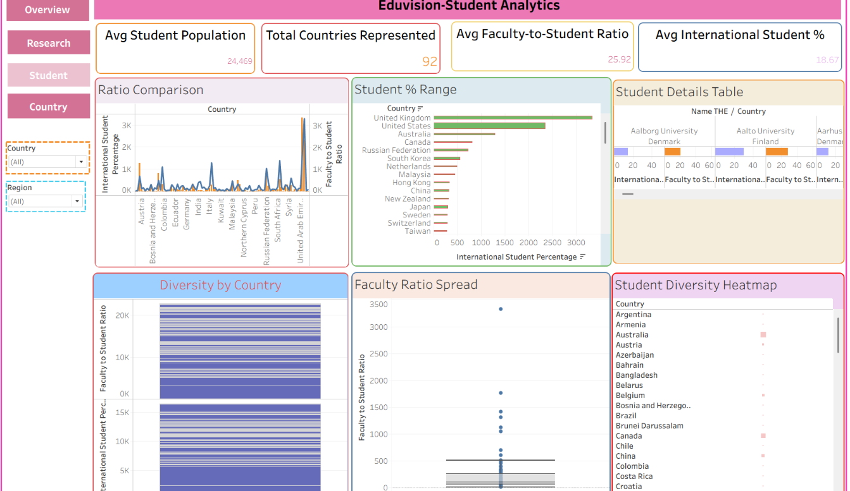
RESULTS / FINAL DASHBOARD
HOME
OVERVIEW
TECH
PROJECT
KPI
ARCH
MODULES
WORK
RESULTS
D1
D2
D3
D4
Student diversity, international participation and faculty-to-student analysis.
03 • STUDENT ANALYTICS
TABLEAU OUTPUT
D1–D4 • click to navigate
PURPOSE
Focuses on student population, international participation and faculty-to-student relationship across countries.
KEY INSIGHTS
Avg student population: 24,469
92 countries represented
Avg faculty-to-student ratio: 25.92
Avg international student: 18.67%
STUDENT ANALYTICS • DASHBOARD
‹ BACK
NEXT ›
03
EDUVISION_DV • SPRINGBOARD INFOSYS
15

Slide 16
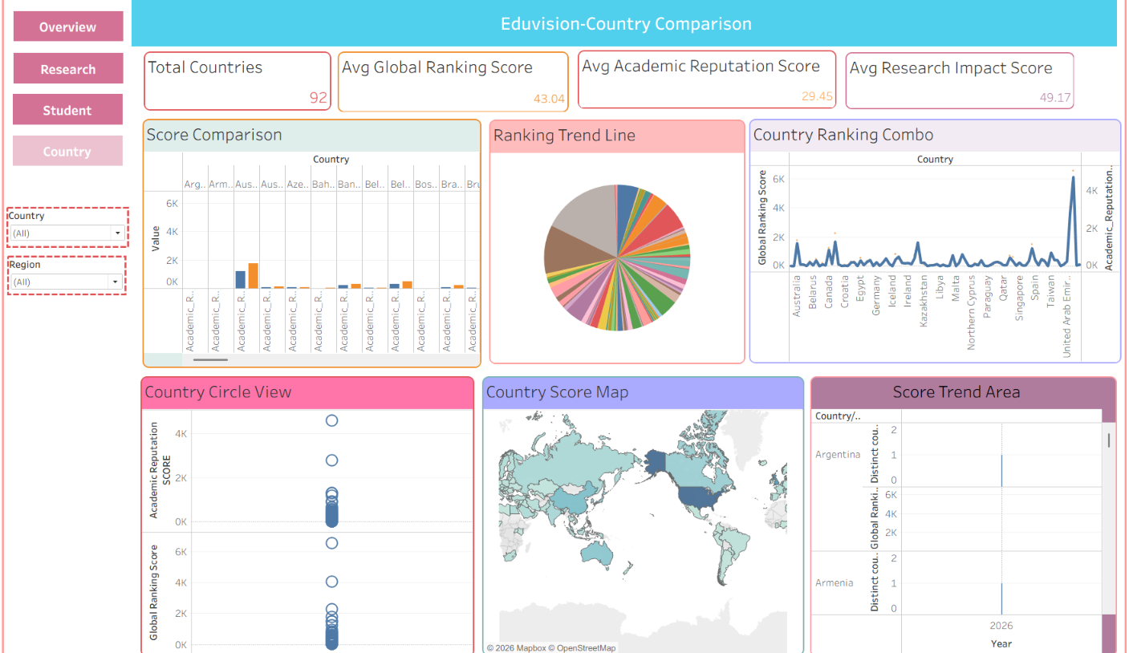
RESULTS / FINAL DASHBOARD
HOME
OVERVIEW
TECH
PROJECT
KPI
ARCH
MODULES
WORK
RESULTS
D1
D2
D3
D4
Country-level benchmarking of higher education performance.
04 • COUNTRY COMPARISON
TABLEAU OUTPUT
D1–D4 • click to navigate
PURPOSE
Compares higher-education performance across countries using ranking, reputation and research indicators.
KEY INSIGHTS
92 countries represented
Avg global ranking score: 43.04
Avg academic reputation: 29.45
Avg research impact: 49.17
COUNTRY COMPARISON • DASHBOARD
‹ BACK
04
EDUVISION_DV • SPRINGBOARD INFOSYS
16

Slide 17
CONCLUSION
HOME
OVERVIEW
TECH
PROJECT
KPI
ARCH
MODULES
WORK
RESULTS
From raw data to
interactive insight.
EDUVISION_DV
6
KPIs
The internship provided hands-on experience in data collection,
data preparation, KPI engineering, Tableau visualization,
dashboard integration, validation and project delivery.
4
Dashboards
8
Weeks
THANK YOU
Mahesh Deshmukh • Springboard InfoSys
EDUVISION_DV • SPRINGBOARD INFOSYS
17

